Slide 1
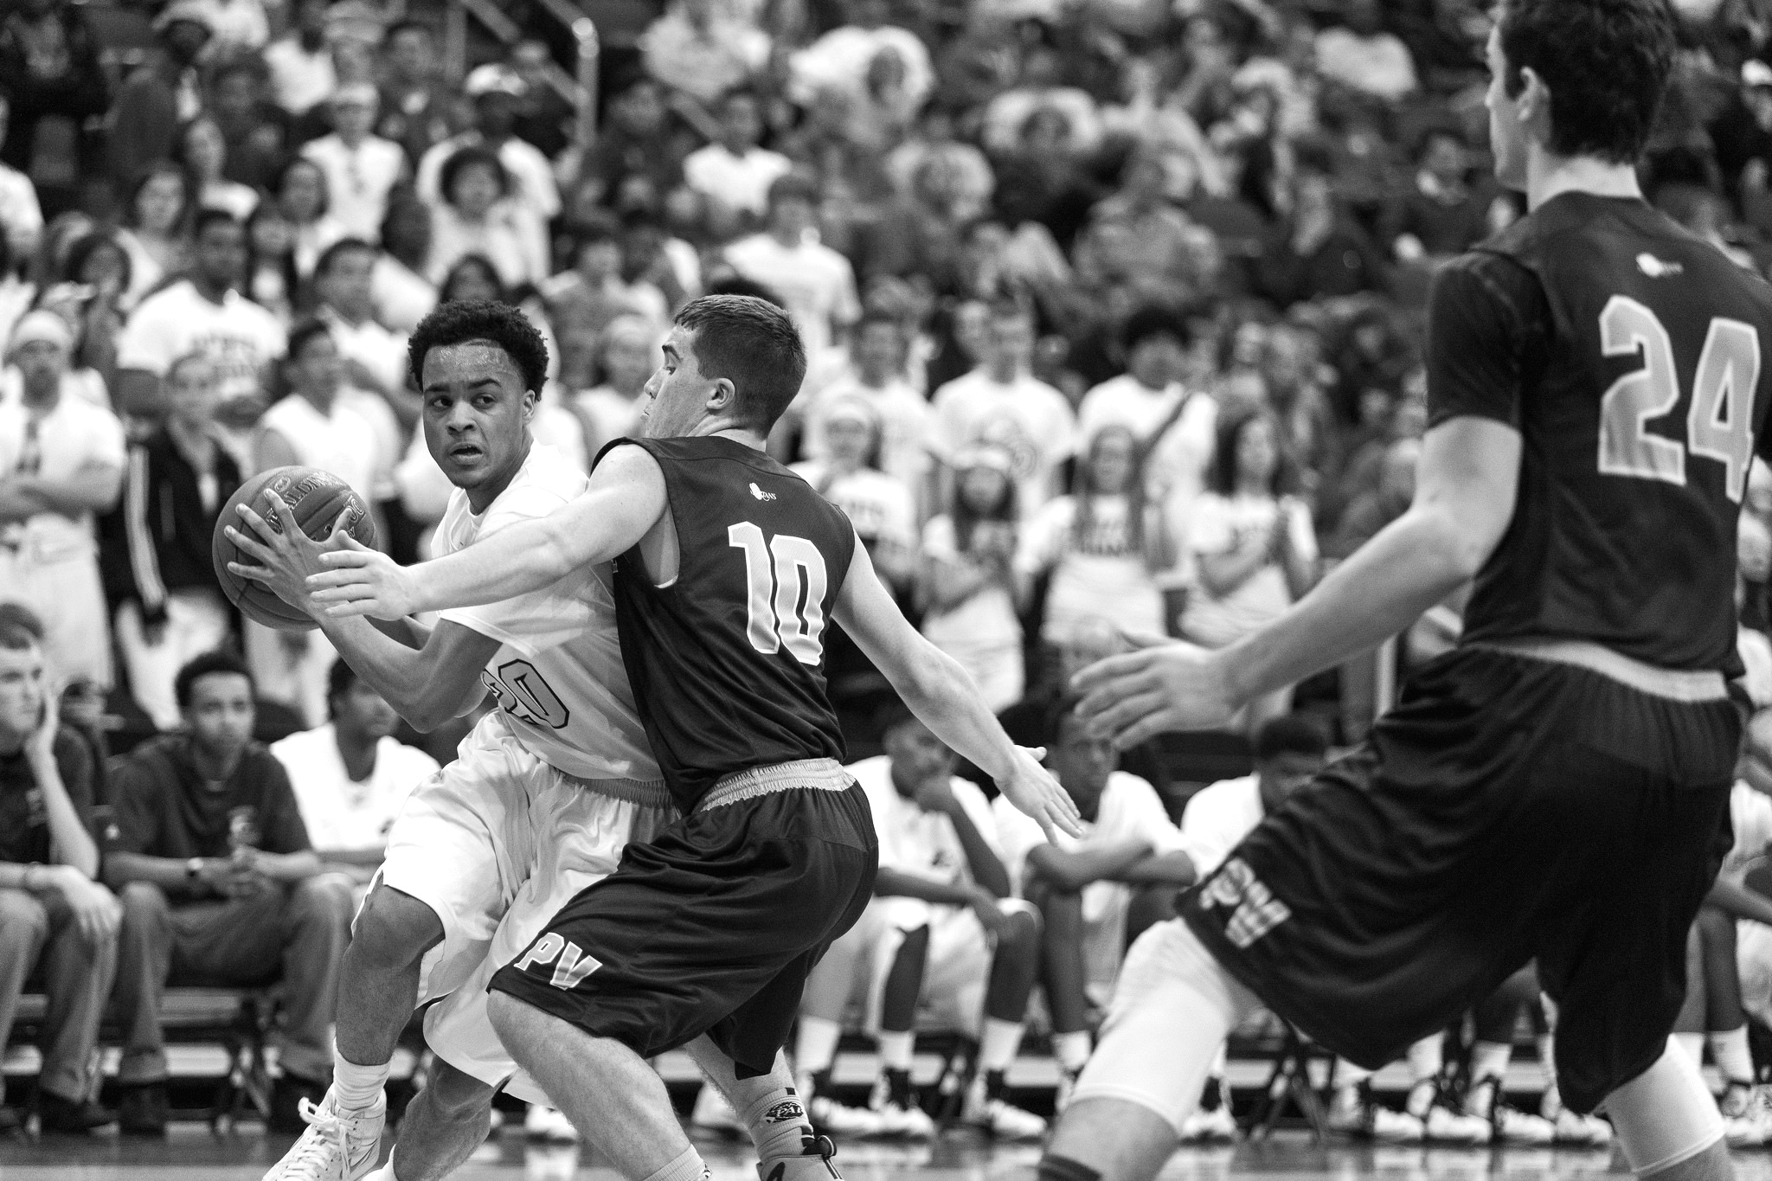

TASK
MADNESS
ON DEMAND
PROCESSING WITH
SPRING CLOUD TASK
TASK MADNESS
ON DEMAND PROCESSING WITH SCT
Notes:
https://www.flickr.com/photos/tabor-roeder/16811793545/

Slide 2
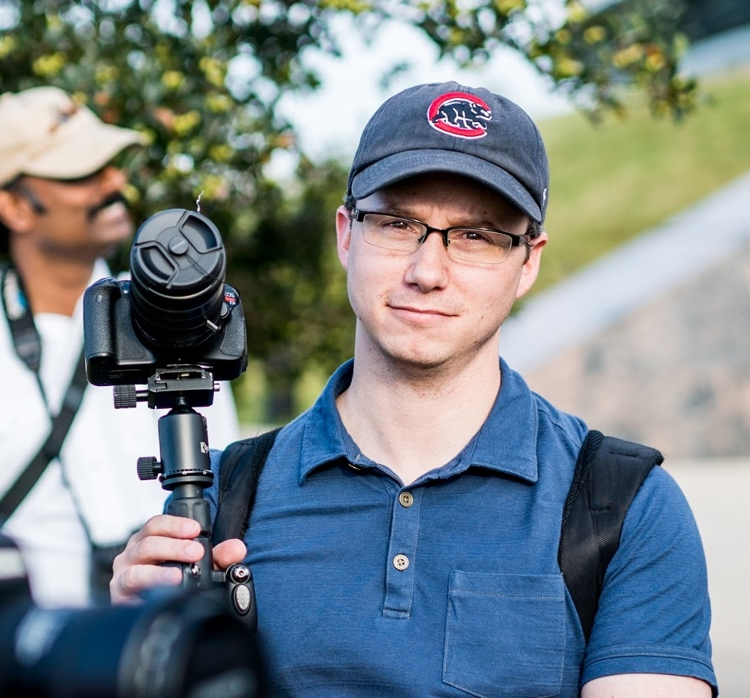
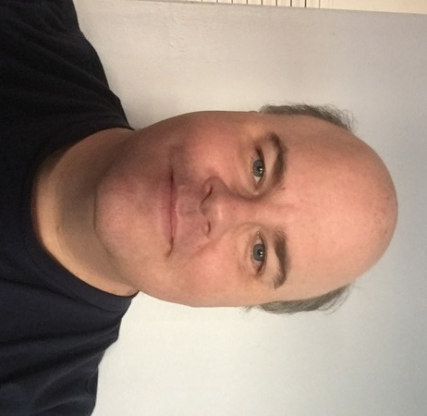
WHO ARE WE?
MICHAEL MINELLA
@michaelminella
@OffHeap
Github: mminella
https://www.spring.io
GLENN RENFRO
@cppwfs
Github: cppwfs
https://www.spring.io

Slide 3


Slide 4
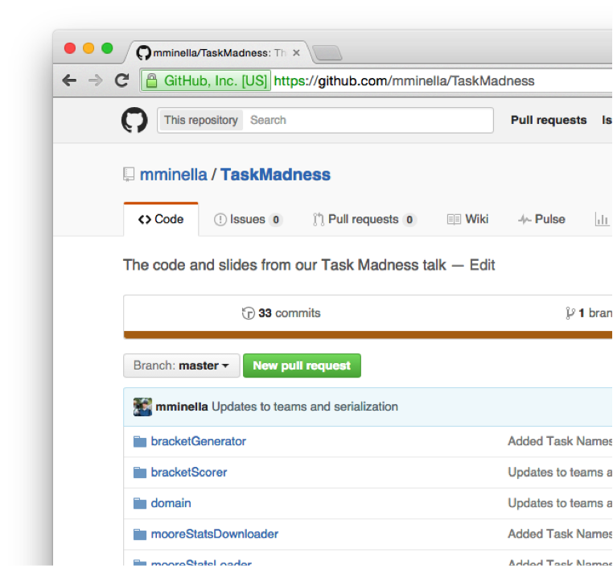

CODE IS ON GITHUB
https://github.com/mminella/TaskMadness

Slide 5


QUICK
POLL

Slide 6
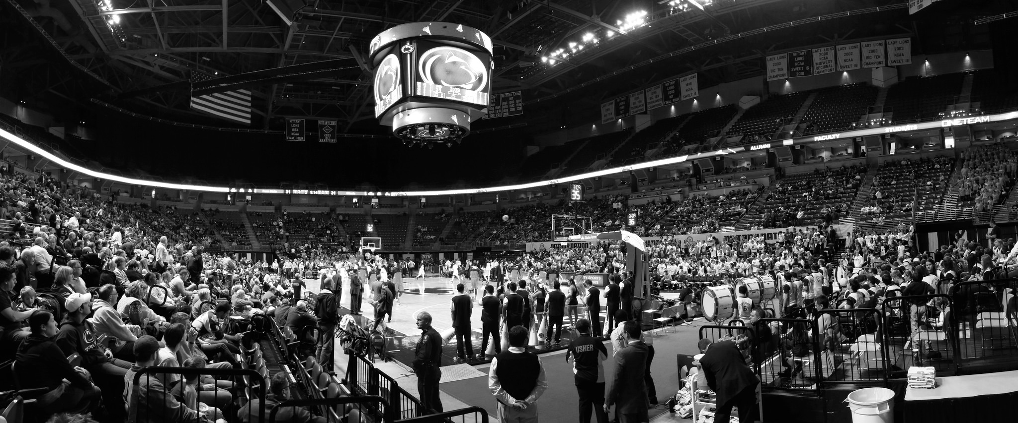
NCAA
MEN’S
BASKETBALL
TOURNAMENT
NCAA Tournament
Notes:
https://www.flickr.com/photos/yuan2003/12959533413/

Slide 7
Infographic for stats on the tournement

Slide 8
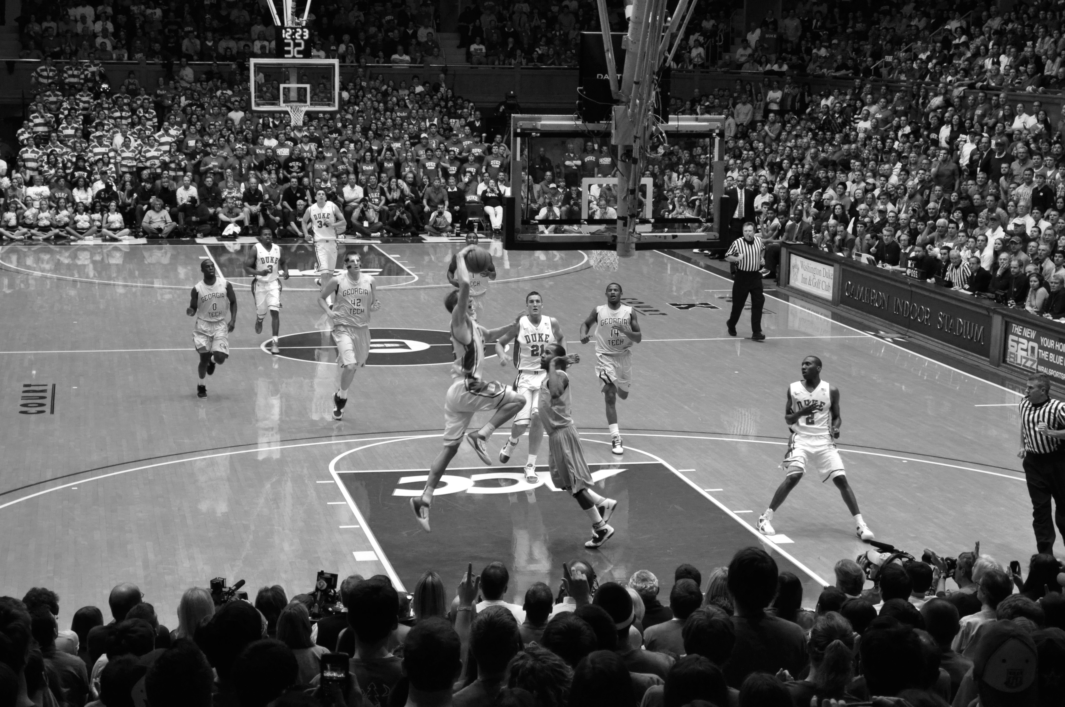

ABOUT THE
TOURNAMENT
Notes:
https://www.flickr.com/photos/whateyesee13/5472188211/

Slide 9
64
TEAMS

Slide 10
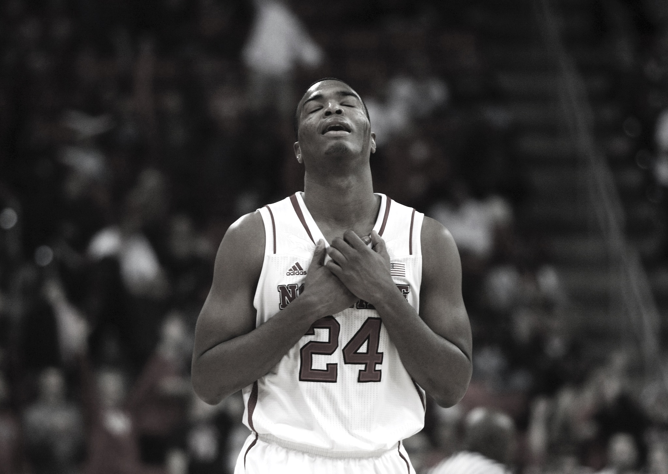

Single elimination
SINGLE
ELIMINATION
Notes:
https://www.flickr.com/photos/romec1/12229748395/

Slide 11
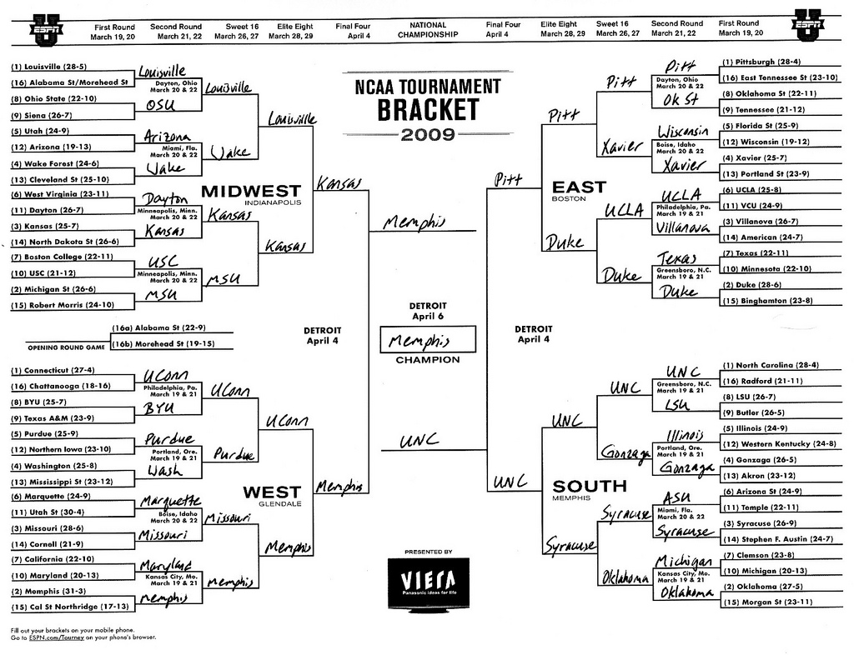
TEAMS
ARE
SEEDED
Teams are seeded

Slide 12
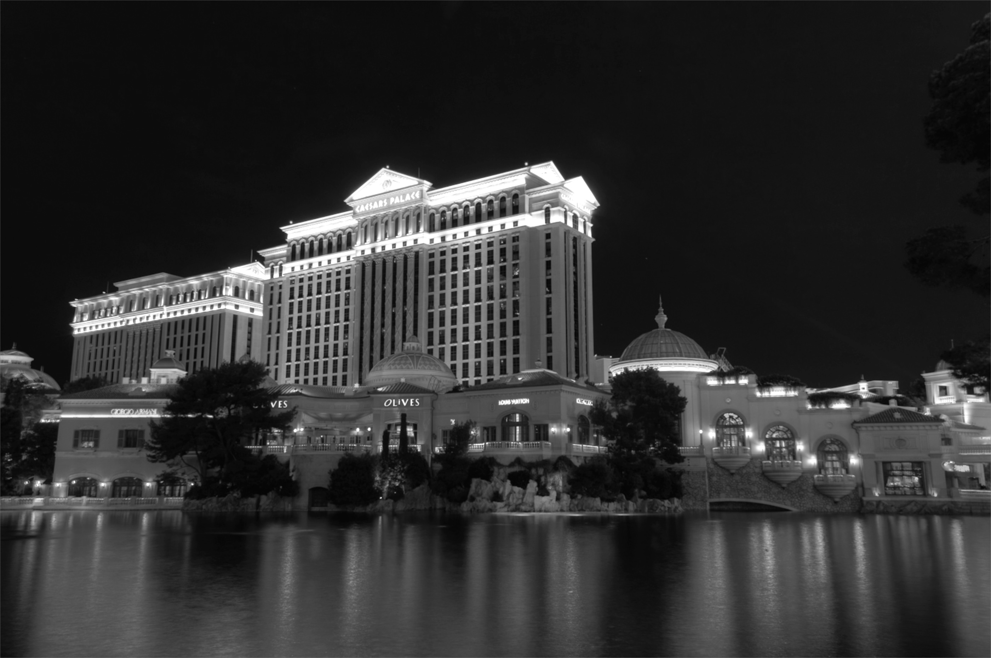

GAMBLING
BASED ON
BRACKETS
Notes:
http://keepingitrealsports.com/wp-content/uploads/2015/03/Obama-Katz.jpg

Slide 13

Not that hard right?
PICK
A PERFECT
BRACKET…
EASY RIGHT?

Slide 14
9 Quintillion possible combinations

Slide 15

NOT
PERFECT
JUST
GOOD
ENOUGH
Notes:
https://www.flickr.com/photos/86530412@N02/7987532186/

Slide 16

WHAT IS
“GOOD
ENOUGH”?

Slide 17

ESPN SCORING RULES
SCORING
RULES

Slide 18
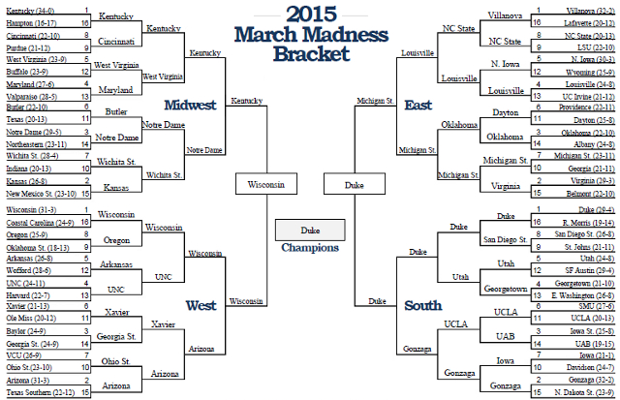
Notes:
3 #1 seeds made the final 4
A #7 seed was the other (that was the “odd” part).
#1 seed (Duke) won

Slide 19

PERFECT
BRACKET IS
1920
Notes:
320 per round * 6 rounds

Slide 20
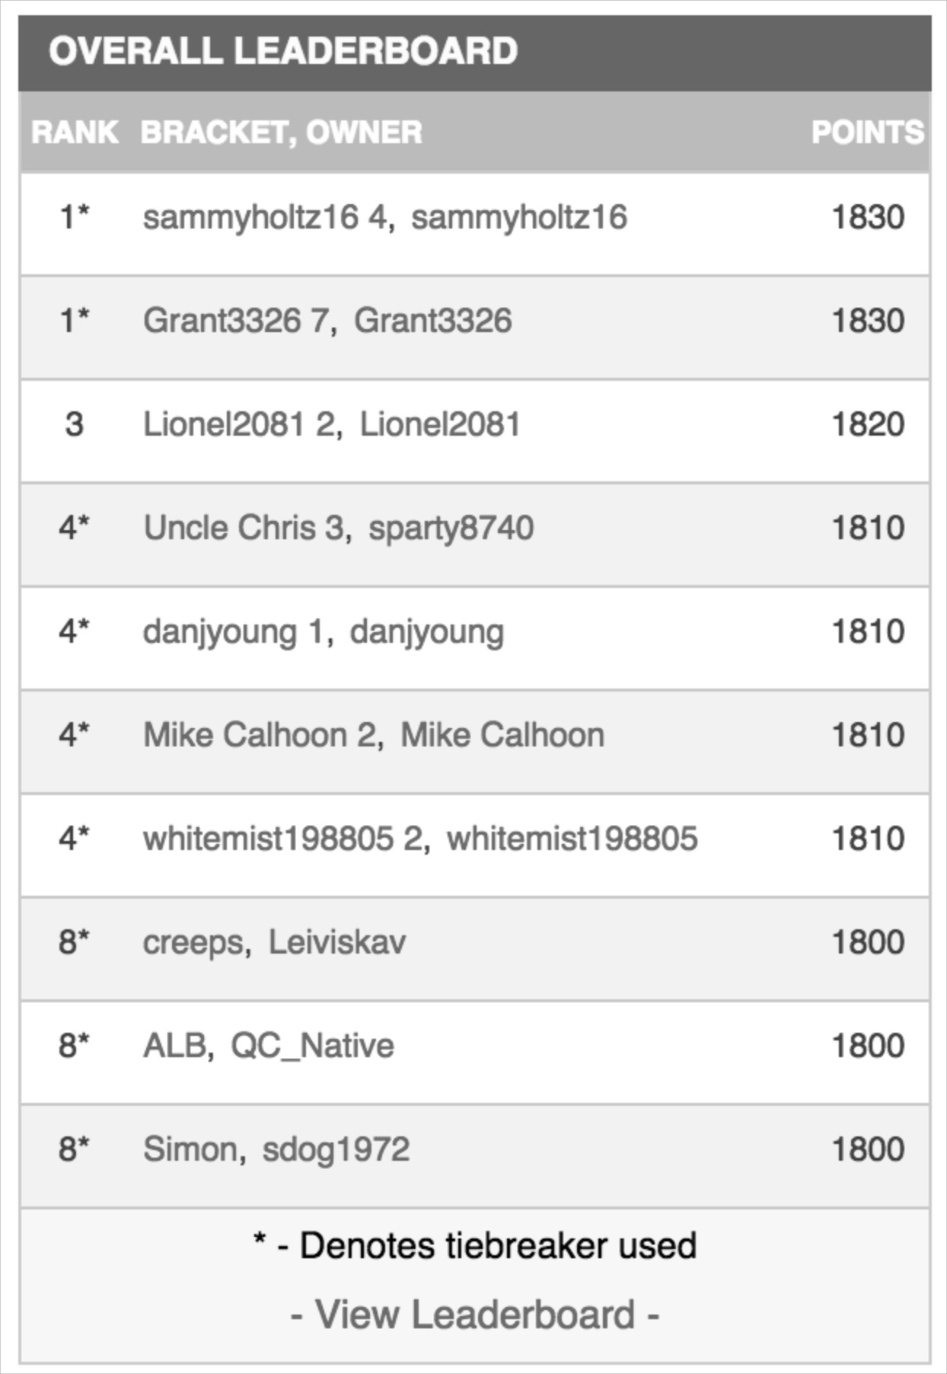

WINNER
SCORED 1830

Slide 21
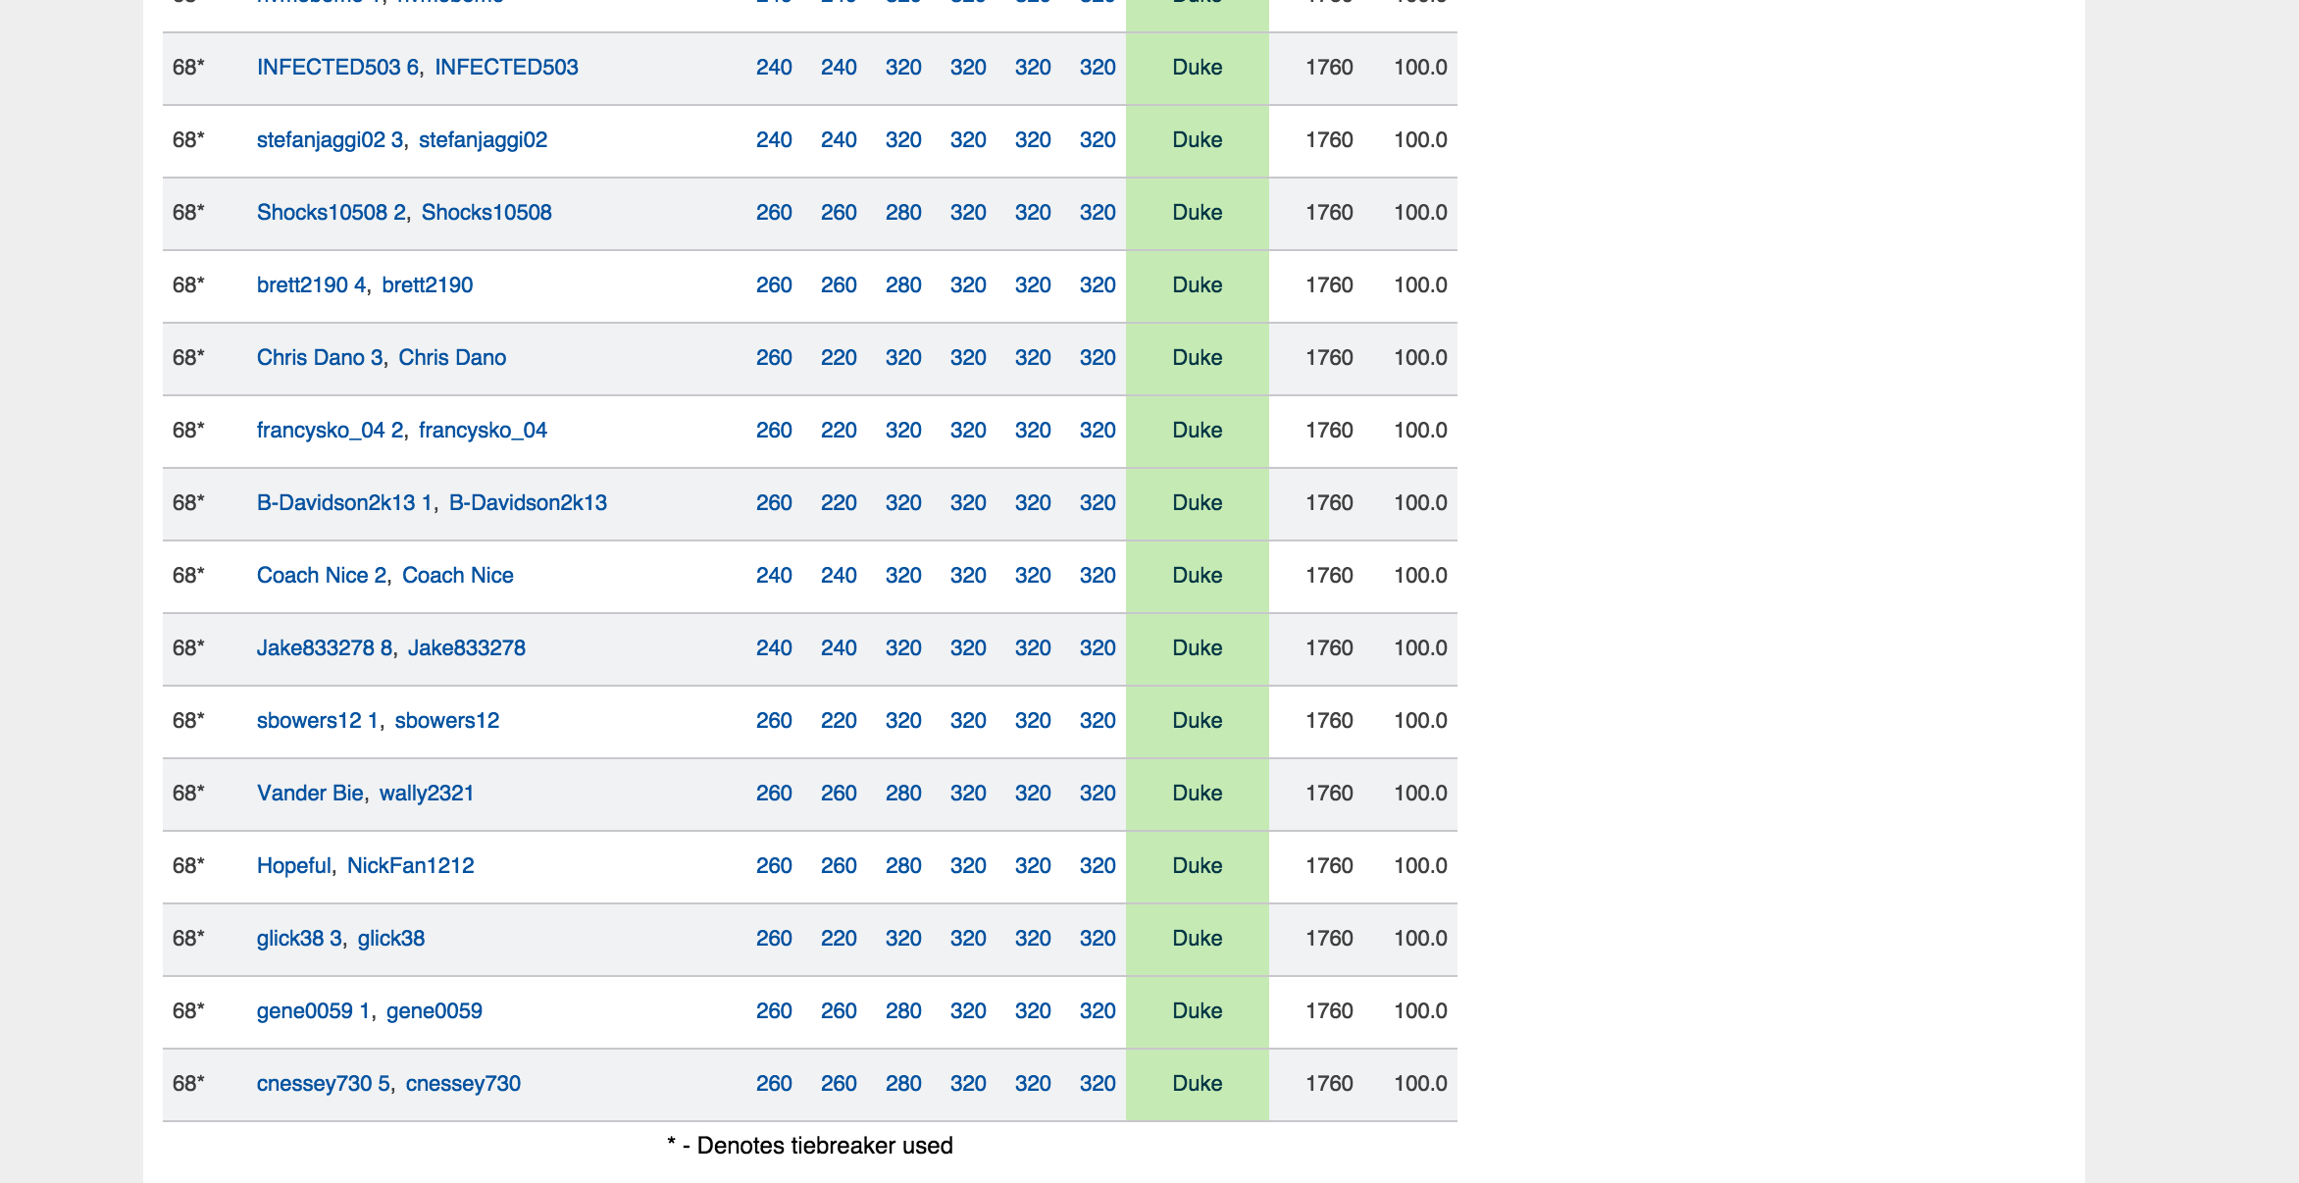
TOP 100
SCORED 1760
Notes:
Top 100 out of 11 million brackets
2014, a much crazier year…The winner had 1730 and to break the top 100, you needed a 1520

Slide 22
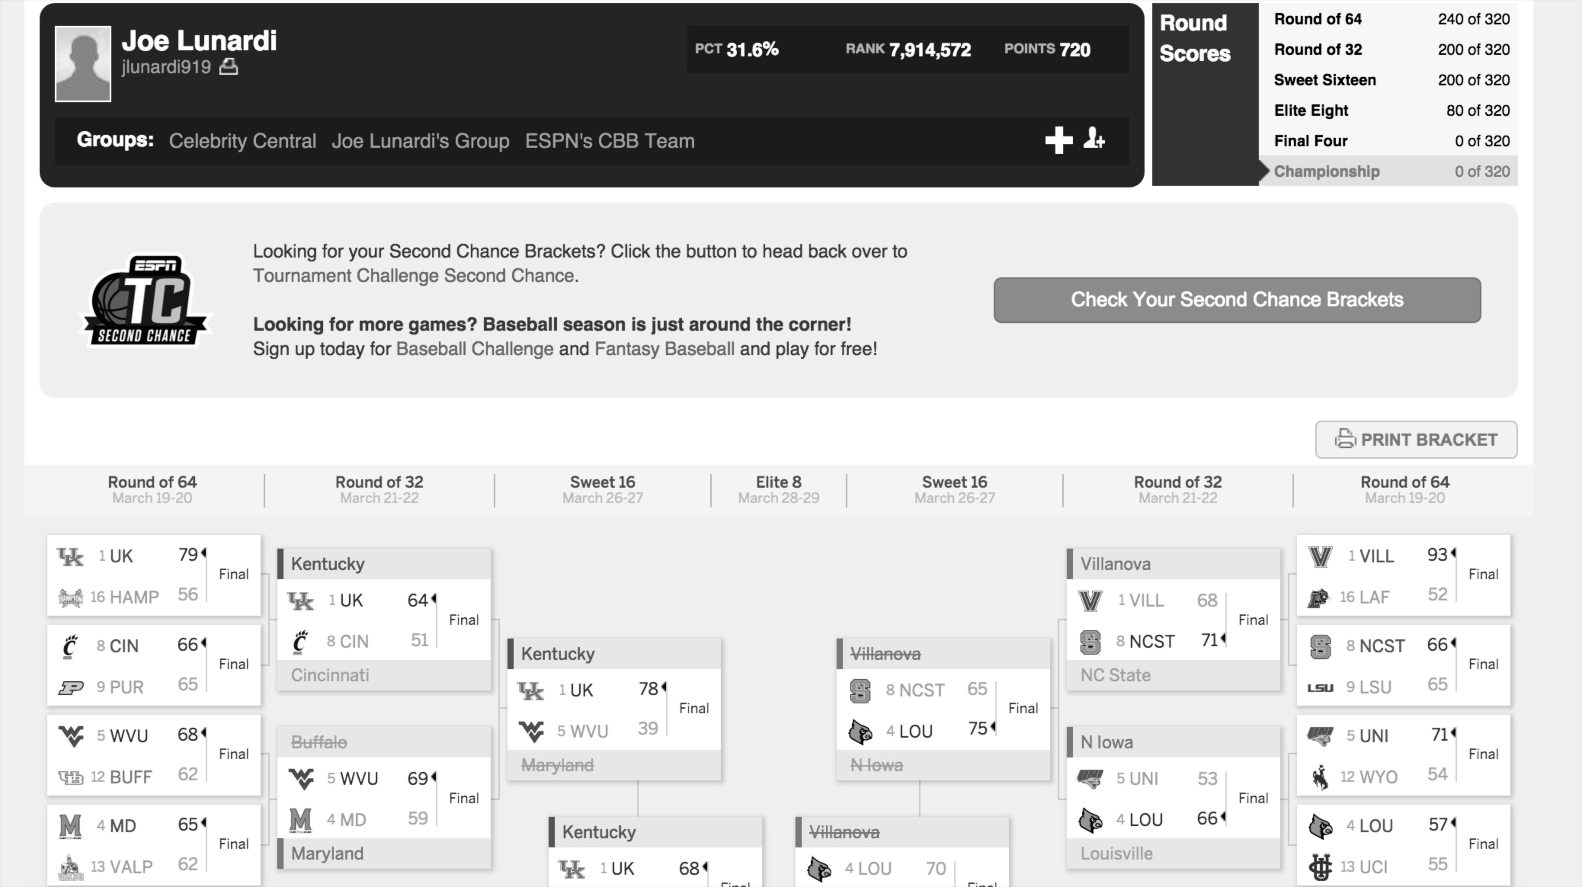
JOE
LUNARDI
720
Joe Lunardi scored 760 in 2015 and 600 in 2014
Notes:
http://games.espn.go.com/tournament-challenge-bracket/2015/en/entry?entryID=4607369

Slide 23
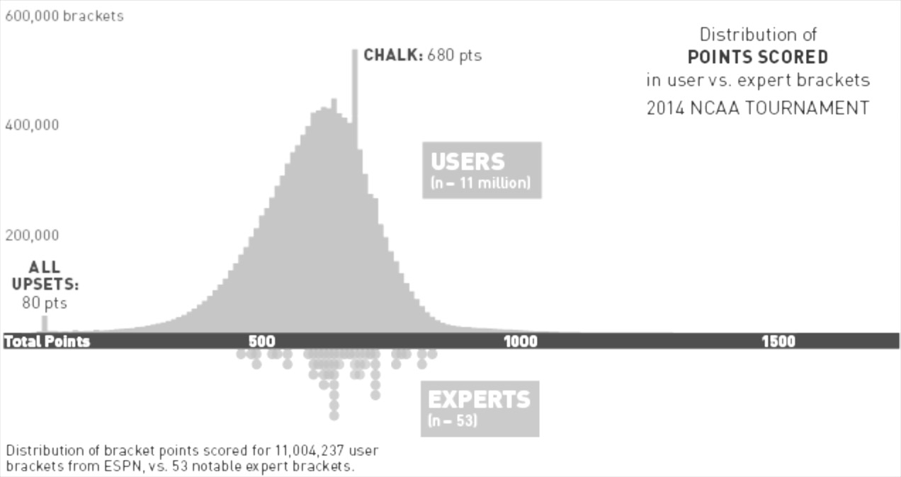

SCORES
TYPICALLY
HAVE A TIGHT
BELL CURVE

Slide 24
We aren’t looking for a perfect bracket

Slide 25

JUST
BETTER
THAN THE
REST OF THE OFFICE
Just one better than everyone else in the office

Slide 26
HOW ARE WE
GOING TO DO
THAT?

Slide 27
GENERATE
MILLIONS OF
BRACKETS

Slide 28

FILTER “BAD” BRACKETS

Slide 29
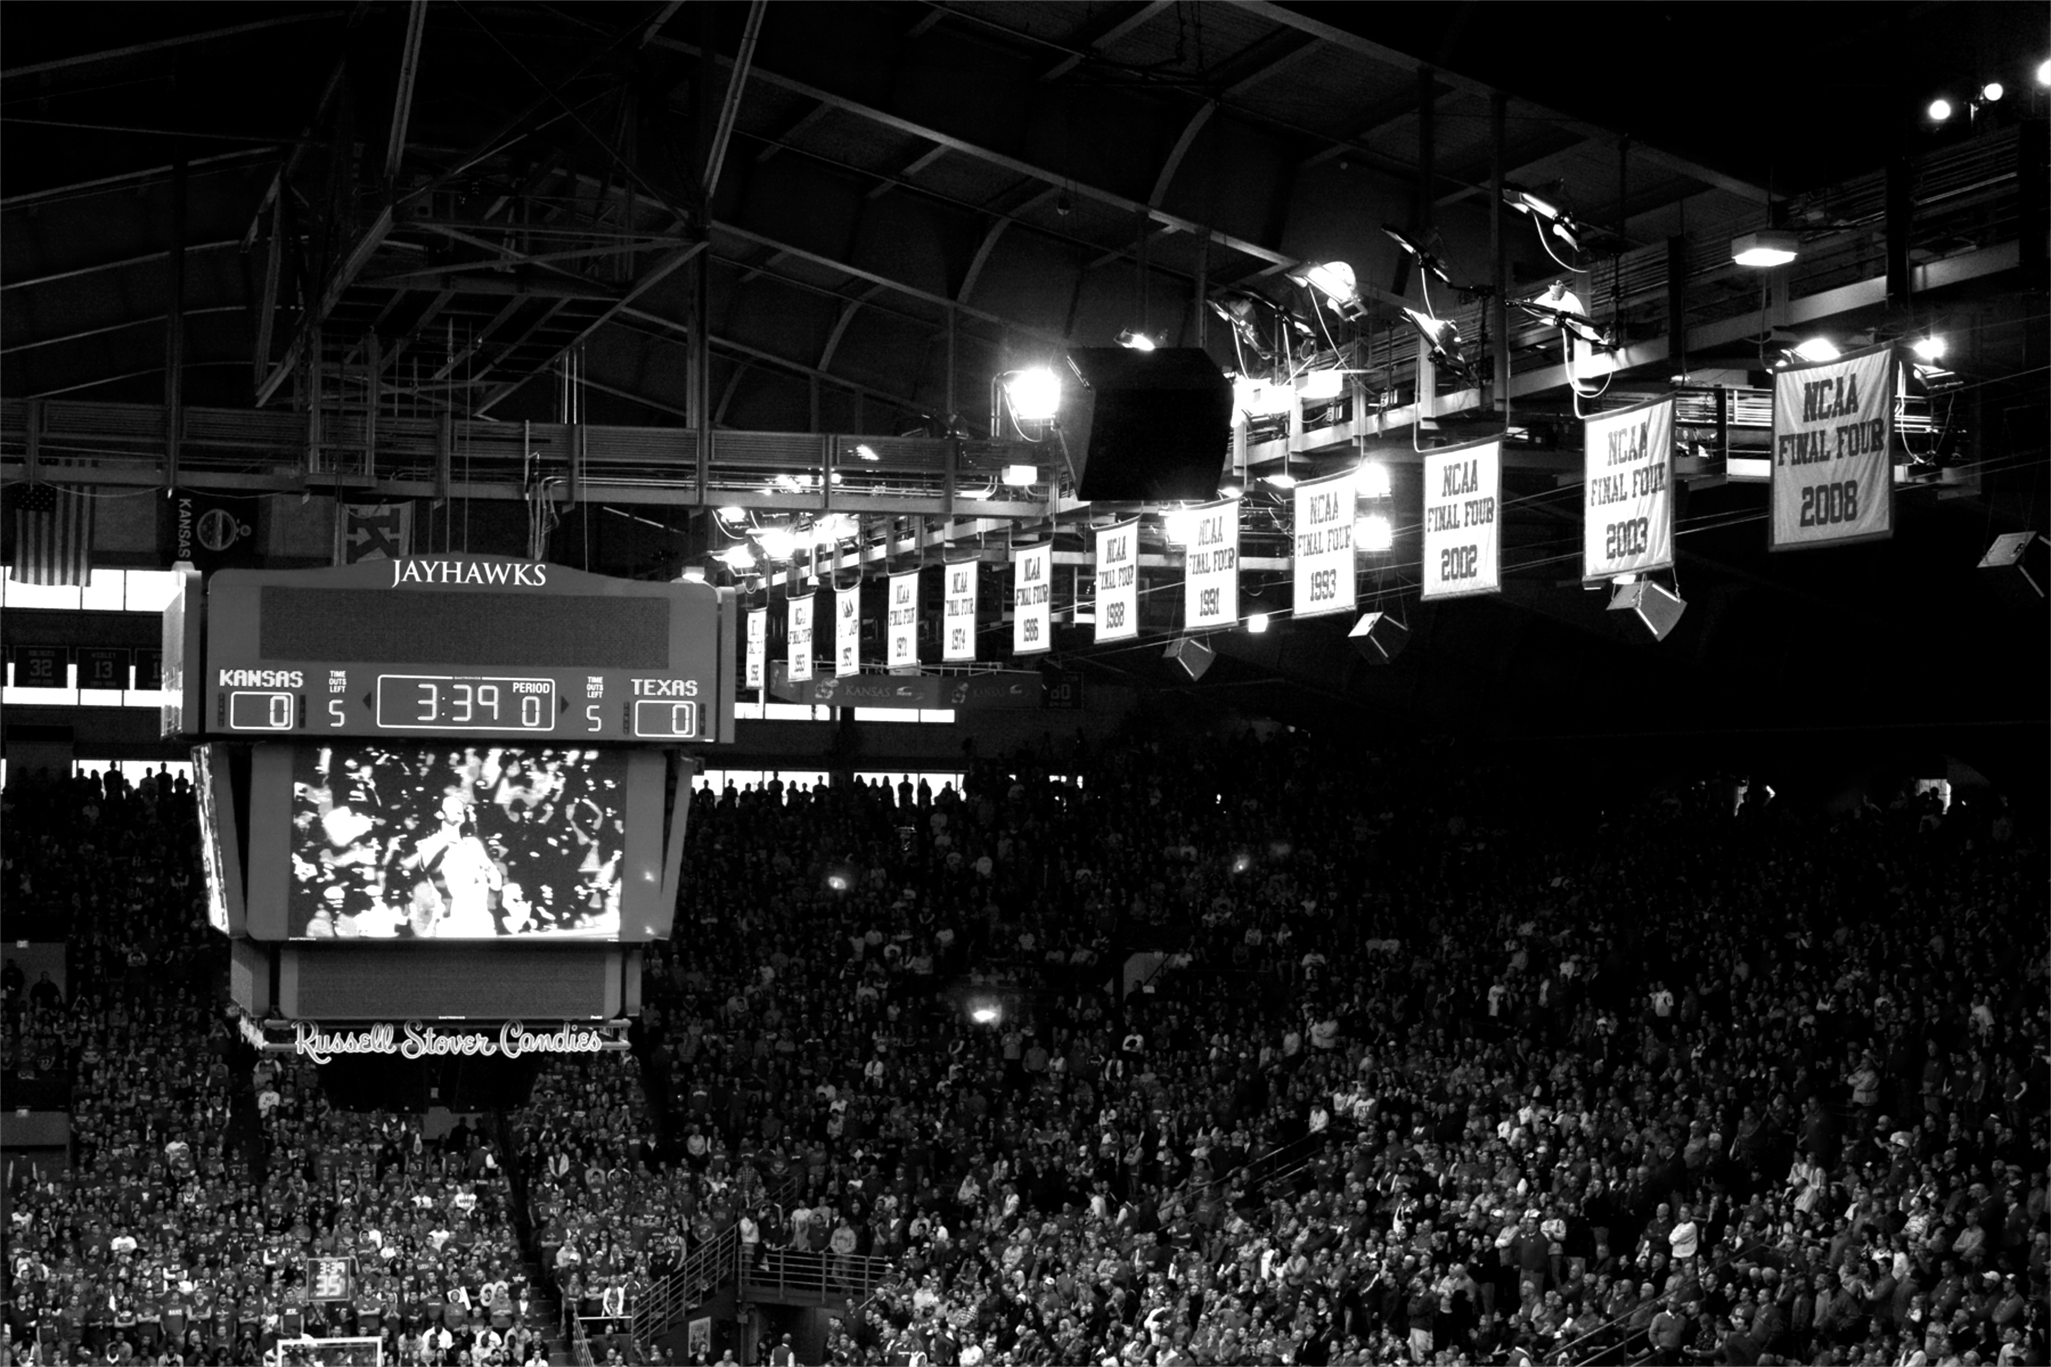
SCORE
THE
REMAINING

Slide 30
HOW
DO WE DO THIS?

Slide 31

Spring Batch!

Slide 32

BATCH ISN’T
IDEAL
Not ideal
Notes:
https://www.flickr.com/photos/donnieray/9436653177

Slide 33
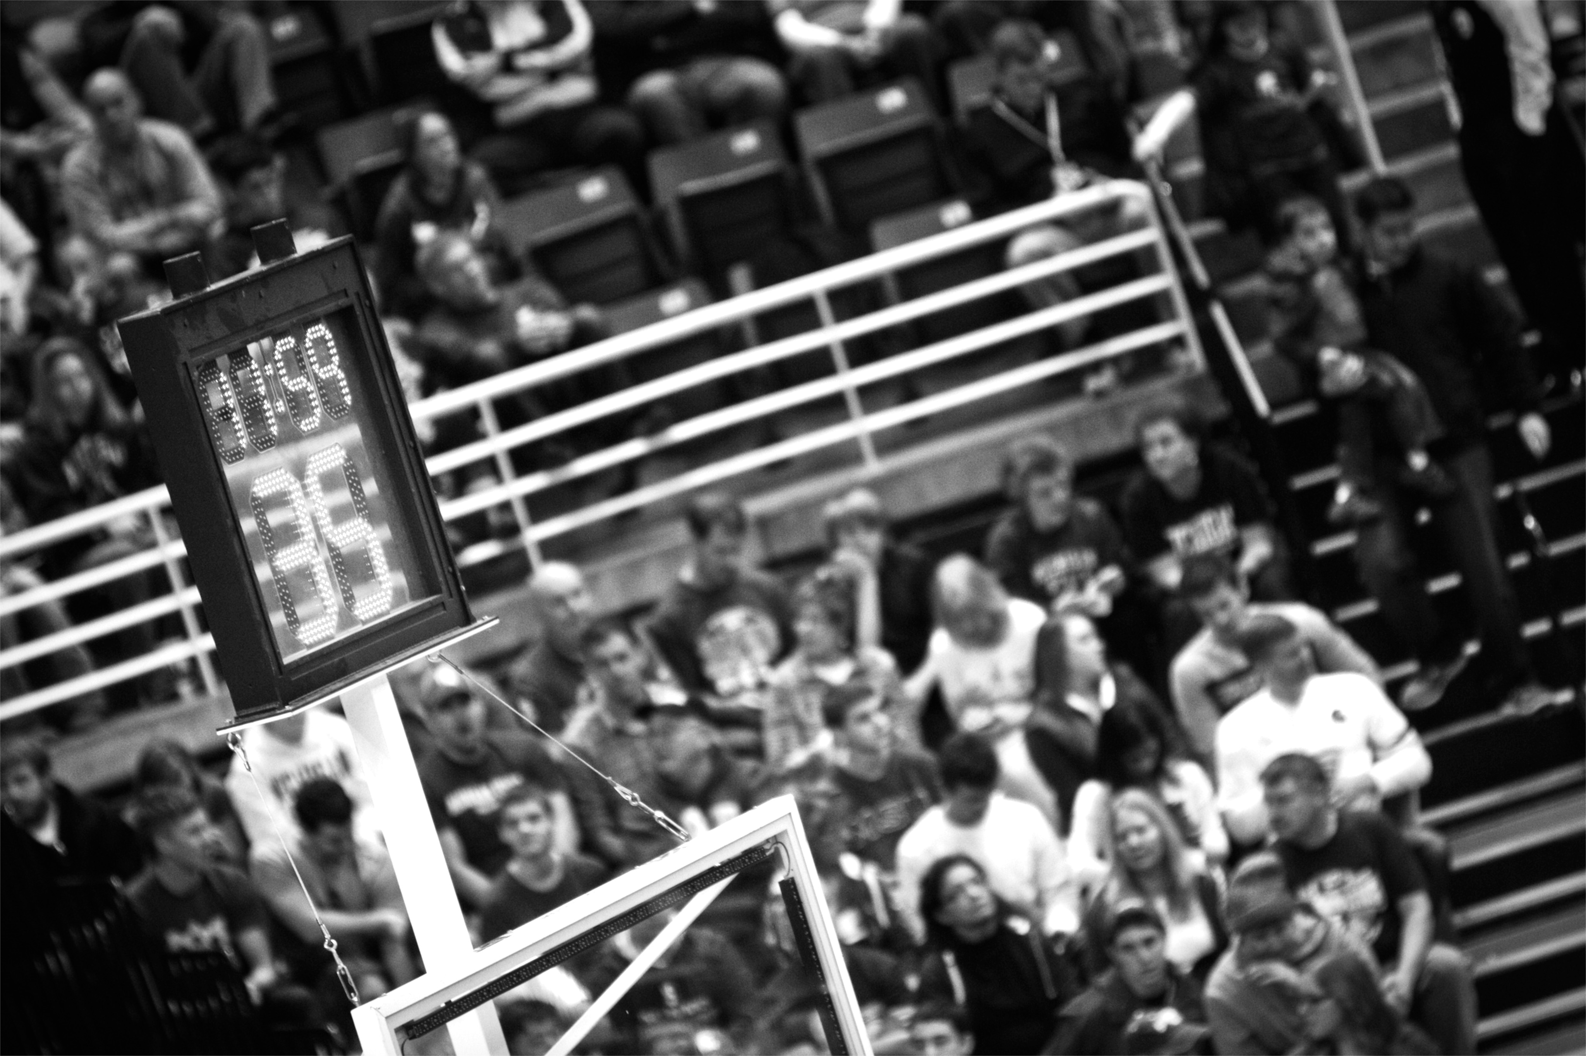
TASKS RUN AT DIFFERENT TIMES
Notes:
https://www.flickr.com/photos/maybourne/11937207616/

Slide 34

DIFFERENT STEPS
SHOULD BE
DECOUPLED

Slide 35
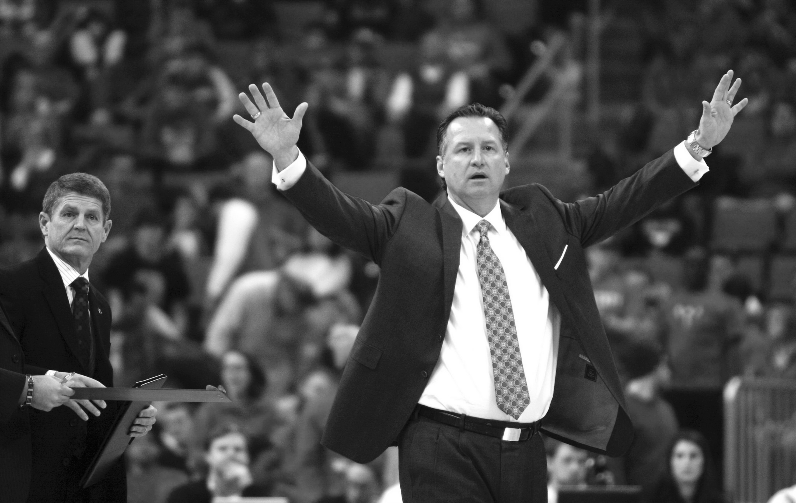
Orchestration should live at a higher level
ORCHESTRATION
OCCURS AT
A DIFFERENT LEVEL

Slide 36
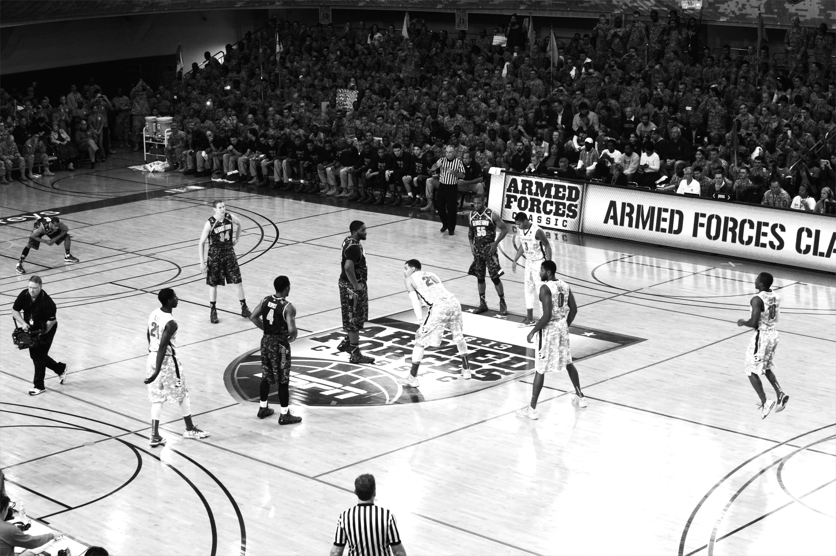
DISTRIBUTED DEPLOYMENT
OPTIONS
Notes:
https://www.flickr.com/photos/usaghumphreys/10917396866/

Slide 37
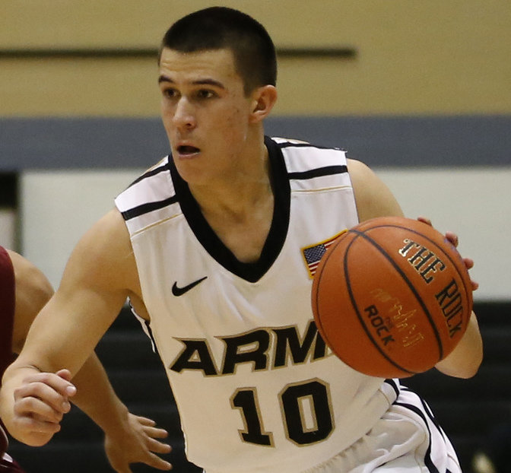
DEVELOP EACH
COMPONENT AS A
MICROSERVICE

Slide 38
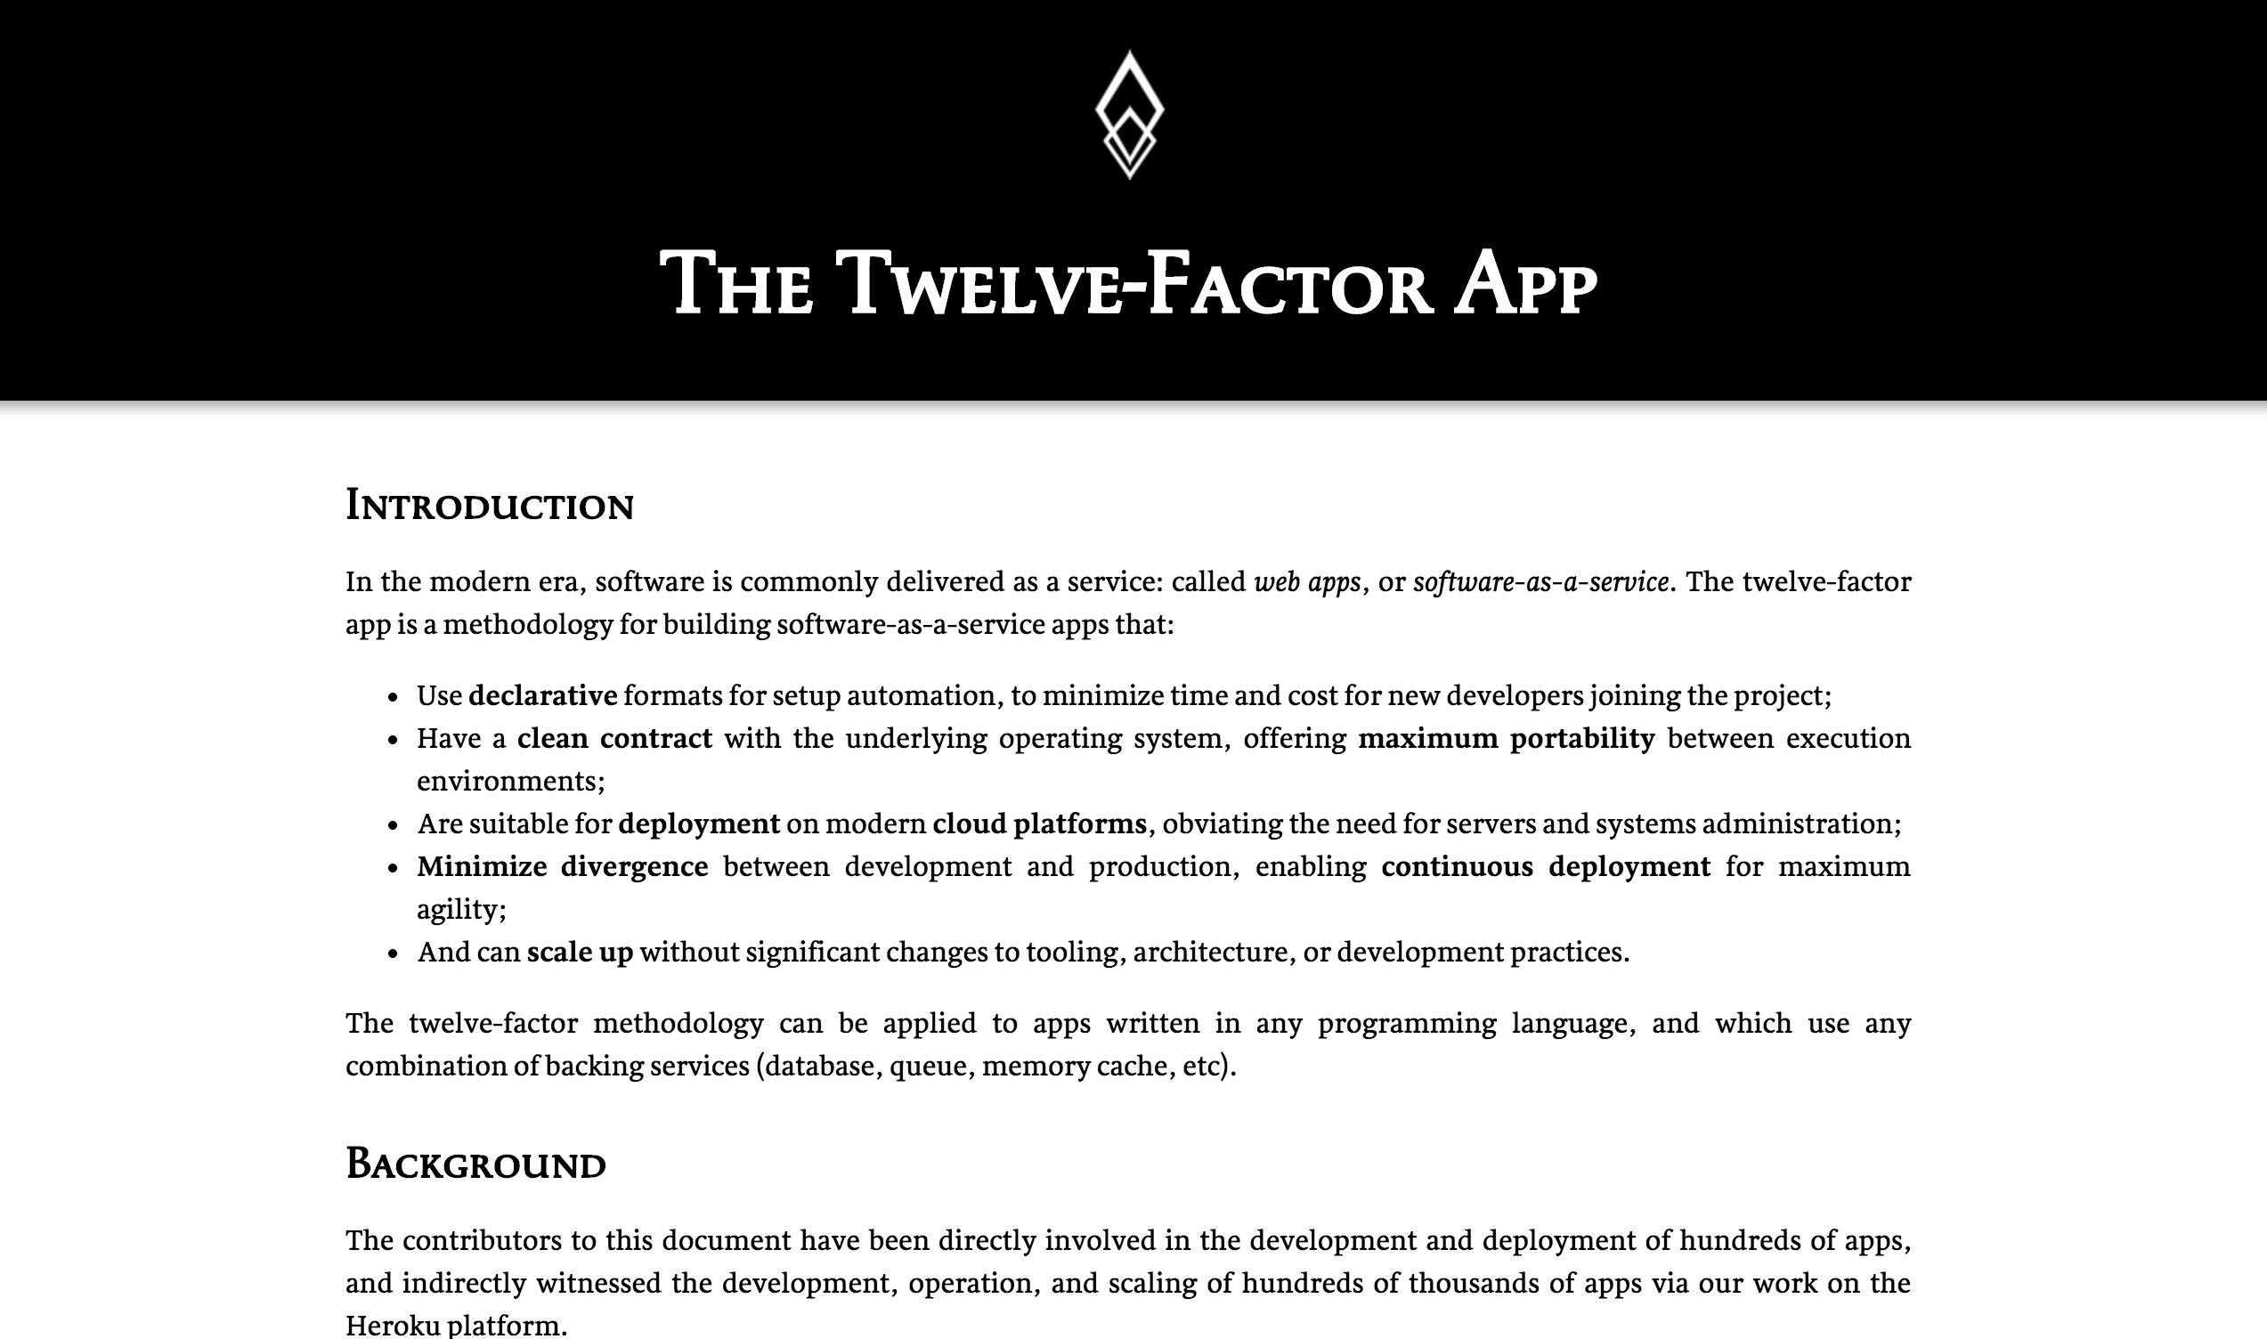
OBEY THE 12
FACTOR APP
PRINCIPALS

Slide 39
Just short lived

Slide 40
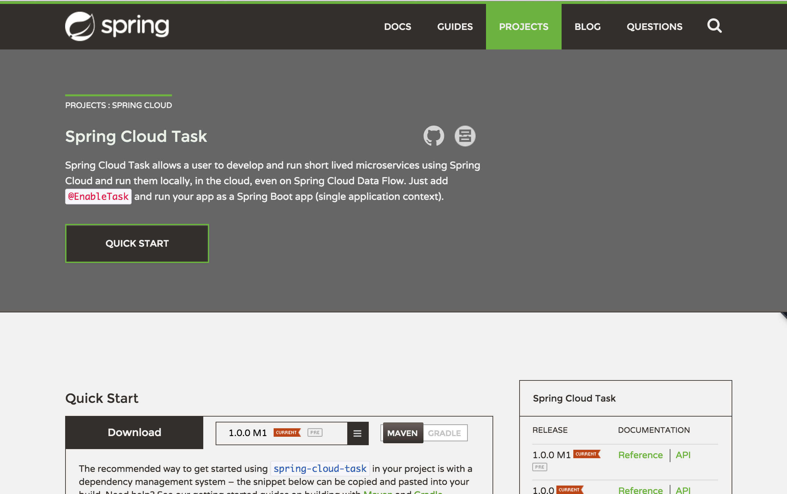

Slide 41

A framework for providing functional and nonfunctional features
for building short lived microservices.

Slide 42
Currently M1

Slide 43
Hello World of Spring Cloud Task

Slide 44
Image walking through our architecture

Slide 45
Demo

Slide 46
Roadmap

Slide 47
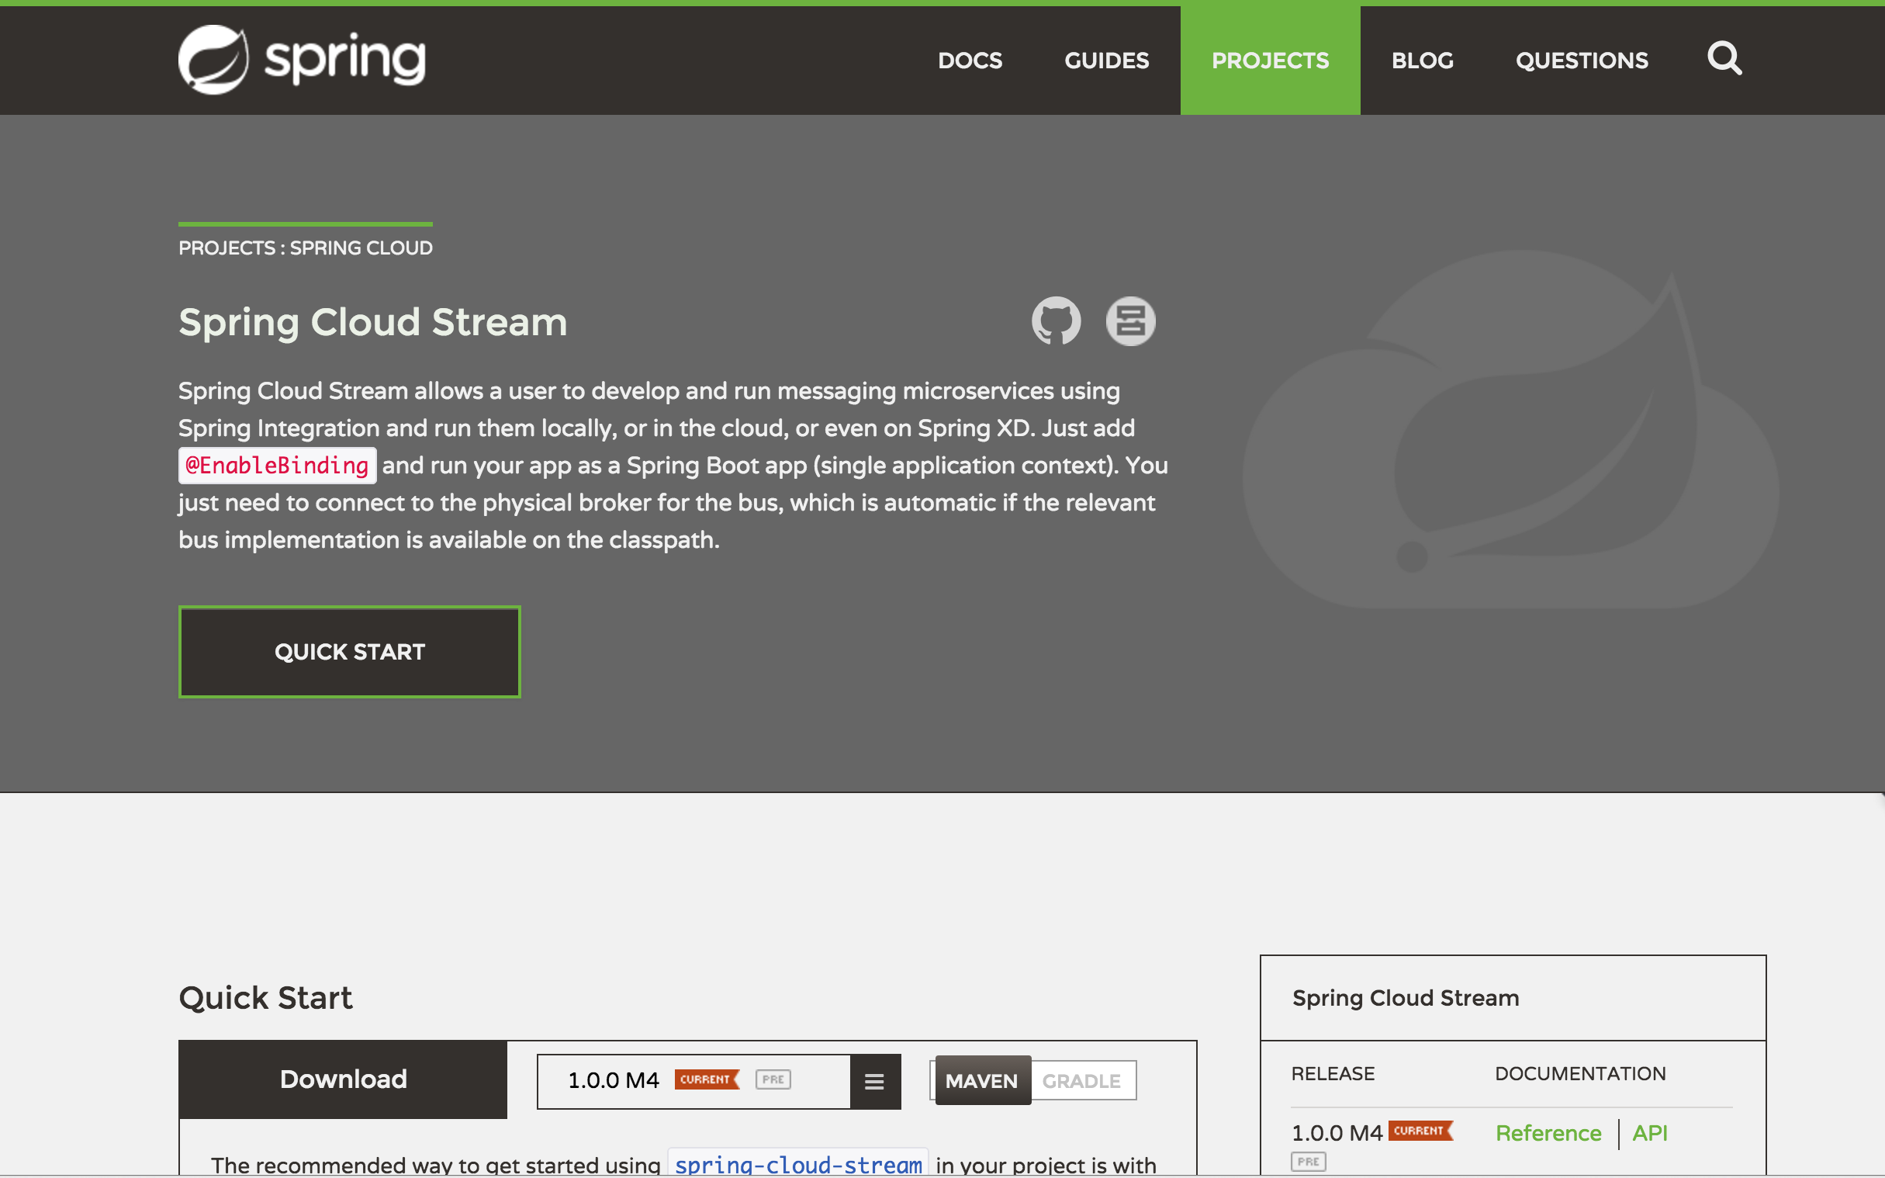
Spring Cloud Stream integration

Slide 48
Spring Batch!

Slide 49
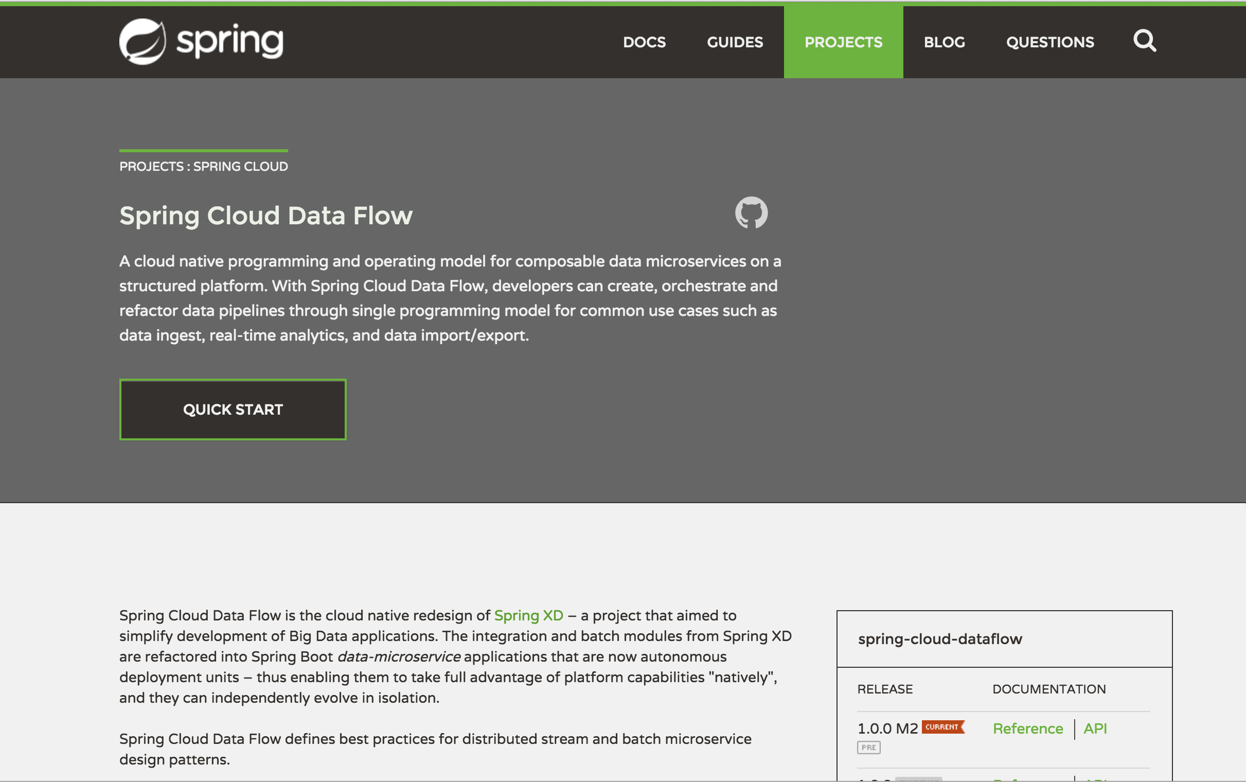
Notes:
Call out tasks replace jobs in SCDF from XD

Slide 50
M2 early next month

Slide 51
GA early Q2

Slide 52

QUESTIONS?

Slide 53
Thanks!

Slide 54
CREDITS

